Slide 1

By
Emirkan Sali
Yashodhan Deshpande
Lochana Abhayawardana

Slide 2
Motivation
Wireless communication widespread and widely used
Wireless sensor networks (WSN) in many modern application areas
The diverse areas of application call for different standards
Low-rate WPAN for low cost, adequate battery life, and easy installation
ZigBee communication protocol as a prevalent low-rate WPAN

Slide 3
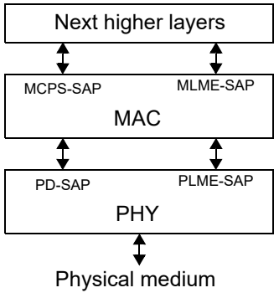
IEEE 802.15.4 Standard - Architecture
Network specification used by ZigBee
One physical and one MAC layer
Physical layer for radio frequency transceivers
MAC layer for transfer access

Slide 4
IEEE 802.15.4 Standard – Network
Two different type of devices:
Full-function device (FFD)
Reduced function device (RFD)
FFD as the central node of a network – PAN coordinator
RFD as a sensor or actuator for low-cost

Slide 5
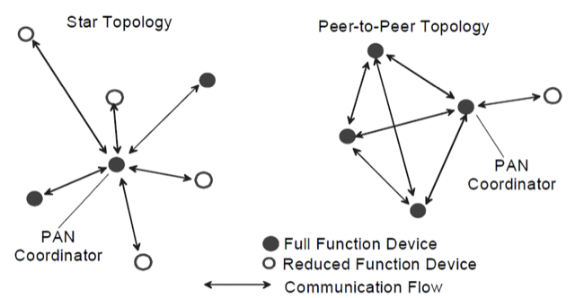
IEEE 802.15.4 - Topology
4 possible topologies using this standard:
Star topology
Peer-to-Peer topology
Tree topology
Mesh topology

Slide 6
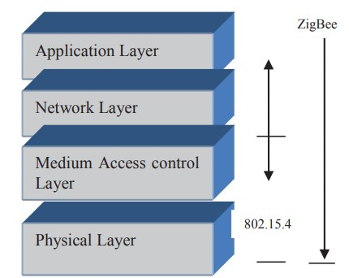
ZigBee Specifications
Expands on the layers of IEEE 802.15.4 standard
Network and application layer added ontop
Each layer has entity for data and management

Slide 7
ZigBee Specifications
2.4 GHz Worldwide with 16 channels and 250 kbps
915 MHz in USA with 10 channels and 40 kbps
868 MHz in Europe with 1 channel and 20 kbps
Uses Star, Mesh or Tree topology
FFD devices for routing in the network – ZigBee routers
RFD devices for communicating with parent device – ZigBee End-devices

Slide 8
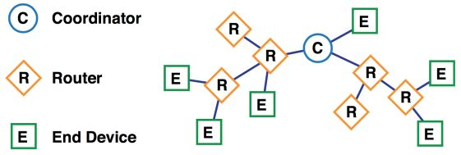
Technical components of a Zigbee network
Coordinator:
Functions as a trust center that provides security control of the network.
Stores and distributes the network keys.
Configures devices, gives permission to other devices to join or leave the network and keeps track of the devices.
Router:
Intermediate nodes between the coordinator and the end devices.
Can route traffic between end devices and the coordinator, as well as transmit and receive data.
Can allow other routers and end devices to join the network.
End device:
It is often low-power or battery-powered device.
Examples are motion sensors, contact sensors, and smart light bulbs.
The end devices do not route any traffic and cannot allow other devices to join the network.

Slide 9
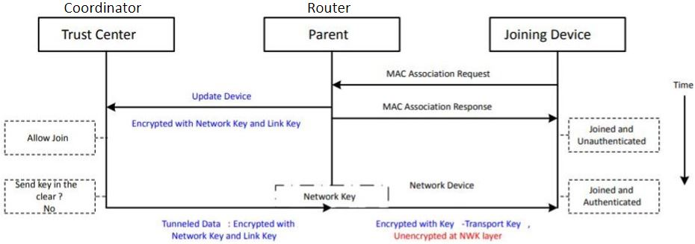
Device Configuration and establishing secured connection
Link key: Encrypting the initial transfer of the network key to a joining node
Pre-configured global link key:
The Zigbee-defined key, 5A 69 67 42 65 65 41 6C 6C 69 61 6E 63 65 30 39 (ZigbeeAlliance09)
Pre-configured unique link key: This link key is usually pre-configured or pre-programmed into the relevant nodes either in the factory or during commissioning.
Zigbee 3.0 - installation code

Slide 10
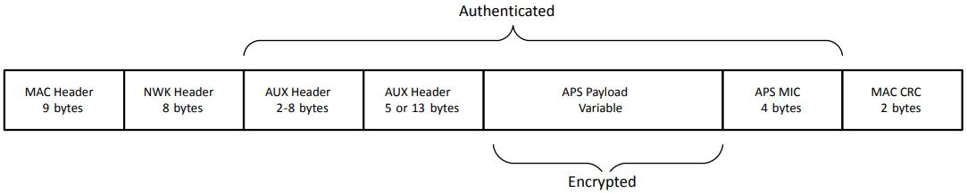
Zigbee data packet and related security
MAC Header: The upper layer sets the MAC layer default key to coincide with the active network key and the MAC layer link keys to coincide with any link keys from the upper layer.
NWK Header: Uses a network-wide key for encryption and decryption.
AUX Header (Auxiliary Header):
Data about the security of the packet that a receiving node uses to correctly authenticate and decrypt the packet.
A frame counter is included in the auxiliary headers.
APS payload (Application Support (APS) layer): Data to be transmitted.
APS MIC (Message Integrity Code (MIC)):
Used to authenticate the message by insuring it has not been modified.
A receiving device verifies the message by calculating MIC against the value written at the end of the message.
MAC CRC ( MAC cyclic redundancy check): Detect errors in the data and information transmitted over the network.

Slide 11

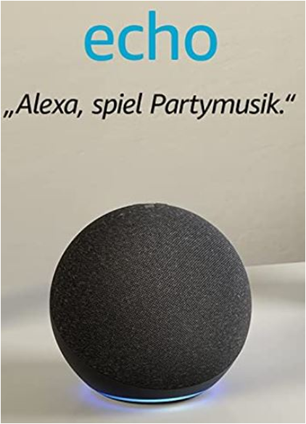
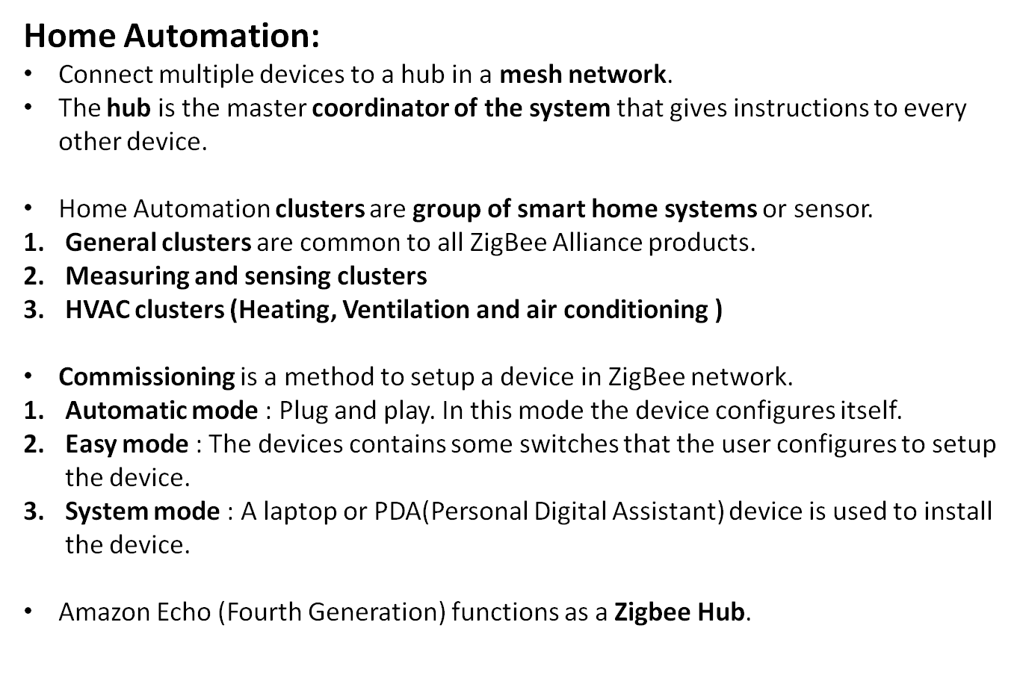

Slide 12
Advantages of ZigBee
Low power consumption: designed to function on low-power and battery-efficient devices
Mesh capability : all the nodes are signal repeaters
High Compatibility: based on a single standard, uses common language and protocols, over 6000 devices
Security and Privacy: 128-bit encryption algorithms and frame counter,
does not require Internet connections

Slide 13
Disadvantages or Challenges to ZigBee
Implementation Cost - infrastructure
Channel noise: Bluetooth, cordless phones, microwaves and other wire- less devices share the common band of 2.4 GHz, overlap/ interference
Low transmission rate: designed for low-rate data transmission, Lower than Wi-Fi and Bluetooth
Security and compatibility: If in a centralised ZigBee system – centralised device fails then all nodes are failed,
Not built-in with smartphone and computers

Slide 14

Comparison with other protocols
Bluetooth:
Bluetooth Special Interest Group (SIG)
Bluetooth Classic, Bluetooth Low Energy (BLE) and Bluetooth mesh
BLE same motivation, Tiney devices required longer battery life
BLE is more power efficient
ZigBee Mesh capability: large scale home automation
House with multi-floors, several rooms
Self-configuring and self-healing

Slide 15
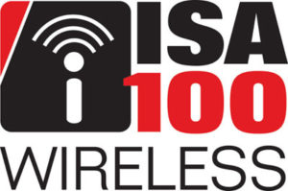
2. ISA100:
developed by International Society of Automation
Focuses on Wireless systems for manufacturing and control applications
mesh network, operate in 2.4 GHz or 900MHz, Higher data rate
ISA100 is industry focused, ZigBee mostly home automation

Slide 16

3. Z-wave:
Danish Cooperation Zensys
Wireless communication protocol, Home automation
Half Duplex
Differences between Zigbee and Z-wave
Data rate: ZigBee 250kbps but Z wave is limited to 40kbps
Frequency: 2.4GHz and 900MHz, but z-wave 99Mhz
Range : 10-75m , Z wave 30m
Cost: ZigBee cheaper than Z-wave

Slide 17
Conclusion
IEEE 802.15.4 Standard - Architecture
IEEE 802.15.4 -Topologie
Zigbee data Packet transmission
Applications of Zigbee
Selecting the communication protocol will depend on the requirements.
Bluetooth
Z wave

